Slide 1


Title Layout
Using Data Science to improve
Heart Disease
Detection
Josiah Joel - 816030501
Raoul Sagram - 816032025
Jarrod Moore - 816028020
subtitle

Slide 2
What is Heart Disease
Heart disease encompasses various conditions affecting heart function
Common types include coronary artery disease, heart failure, arrhythmias, and congenital defects
Globally, heart disease accounts for a significant portion of deaths, according to WHO
Lifestyle changes and medical interventions can mitigate risk factors and improve outcomes
Aim: Maximize the F1 score in 3 traditional prediction algorithms and find the most impactful features to raise awareness and reduce the risk of CVD in Trinidad and Tobago

Slide 3

Causes of Heart Disease

Slide 4
Causes of Heart Disease
Unhealthy diet
Lack of physical activity
Smoking
Hypertension
High cholesterol
Diabetes
Obesity
Age

Slide 5

Chosen Solution
Utilized three state-of-the-art algorithms:
Logistic Regression
Random Forest
Artificial Neural Networks
Conducted binary classification
Objective: Maximize F1 score
Identified the four most impactful features
He ded

Slide 6
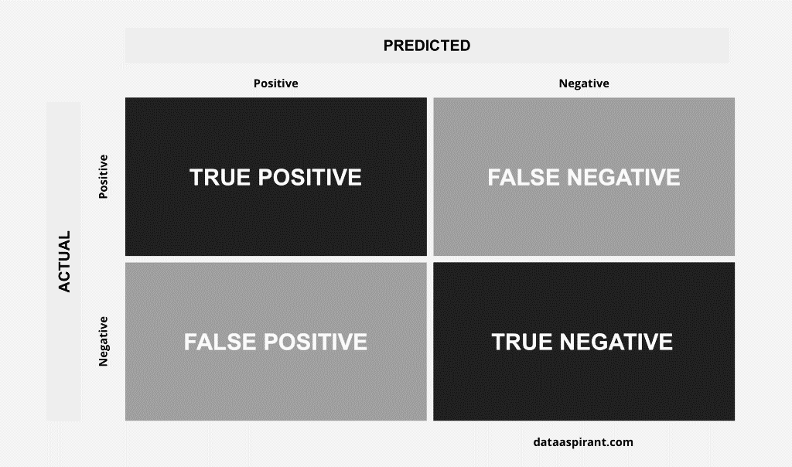

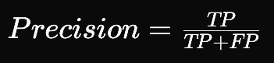

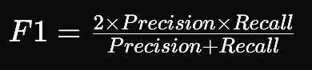
F1 Score
balances both precision and recall
minimizing false positives and false negatives

Slide 7

Experimental Design
Datasets were balanced already
Removed outliers from numerical columns.
All algorithms employed the same cleaned datasets for fairness.
K-Fold cross validation was done.
Compared performance of Logistic Regression and ANN with one-hot encoding against Random Forest and ANN without one-hot encoding.

Slide 8

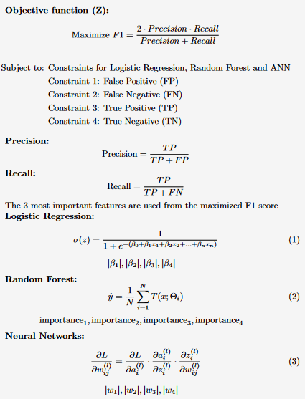
Mathematical Model

Slide 9

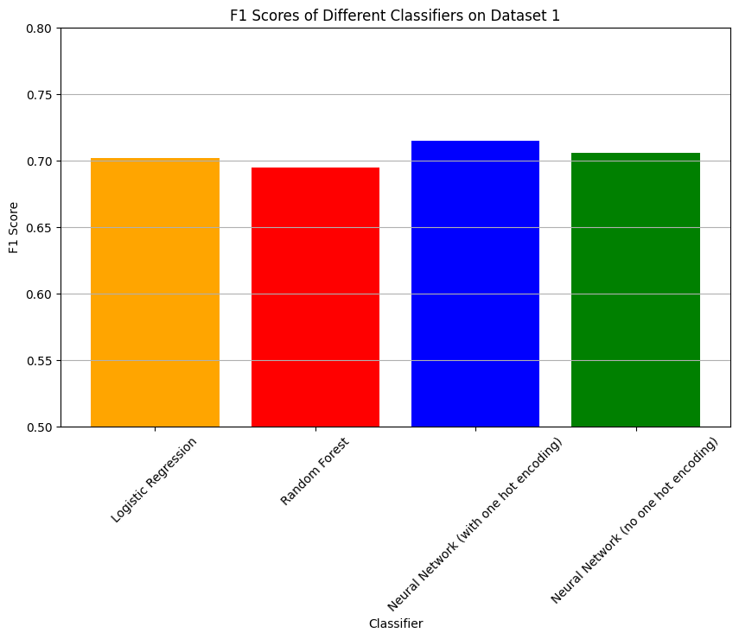
Results
Dataset 1
Best Algorithm = ANN with one hot
Highest F1 score = 0.714
Most Important Features:
Cholesterol (Well above Normal)
glucose (2)
Cholesterol (1)
gender (1)

Slide 10
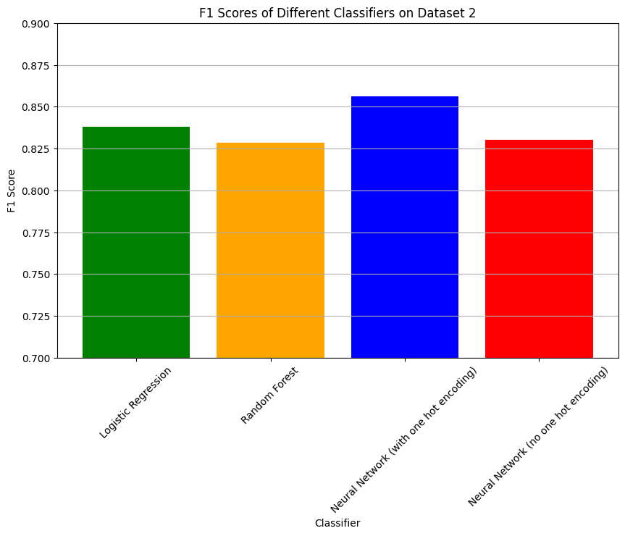
Results
Dataset 2
Best Algorithm = ANN with one hot
Highest F1 score = 0.844
Most Important Features:
ST_Slope (down sloping)
Sex (Male)
ST_Slope (flat)
ChestPainType (Atypical Angina)

Slide 11
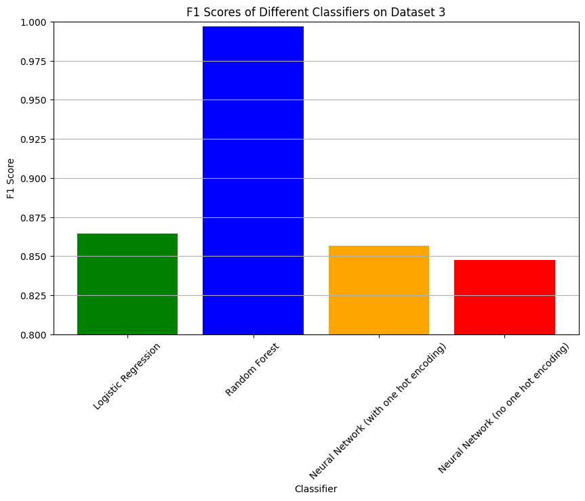
Results
Dataset 3
Best Algorithm = Random Forest
Highest F1 score = 0.997
Most Important Features:
Chest Pain
Thalach
Ca
Oldpeak
Overfitting most likely present.

Slide 12
Discussion
Over fitting present in Random Forest
Neural Network with one-hot encoded data consistently performed best across all datasets.
Identified top four impactful features for each dataset.
Features included cholesterol level, gender, alcohol consumption, glucose levels, ST slope, type of chest pain, oldpeak, maximum heart rate achieved, and number of major blood vessels colored by fluoroscopy.
These features are crucial indicators for predicting cardiovascular disease risk.

Slide 13

Conclusion
Cardiovascular disease is a significant global health concern, including in Trinidad and Tobago.
Predicting disease risk from health aspects is crucial for combating cardiovascular disease.
Utilizing an artificial neural network with one-hot encoded features is effective for CVD predictions.
Analysis of three datasets revealed key features for predictive models, including cholesterol level, gender, alcohol consumption, glucose level, and type of reported chest pain.
Collecting data on these features is essential for creating applicable cardiovascular disease prediction models.

